Slide 1
Fault Tree Analysis
Ehsan Saeedi
97723272
Spring-2019
Notes:
A fault tree is a top-down logic diagram that displays the logical interrelationships between a potential critical event in a system and the causes of this event.
The causes at the lowest level are called basic events and may be component failures, environmental conditions (i.e., events that are expected to occur during the life span of the system).
In this paper, at first, I review the standard FTA and describe the limitations of this approach with an example .
In doing this, I have reviewed more than 200 papers on fault tree analysis, extensions of fault trees and model-based dependability analysis concepts.

Slide 2
Agenda
Introduction
History
Standard fault tree
Extensions
Model based dependability analysis
Conclusion

Slide 3
Introduction
The main objectives of an FTA are:
Identify all possible combinations of basic events that may result in a critical event.
Find the probability that the critical event.
Identify aspects of the system that need to be improved.
Notes:
The main objectives of an FTA are:
(a) To identify all possible combinations of basic events that may result in a critical
event in the system.
(b) To find the probability that the critical event occurs during a specified time
interval or at a specified time t, or the frequency of the critical event.
(c) To identify aspects (e.g., components, safety barriers, structure) of the system
that need to be improved to reduce the probability of the critical event.

Slide 4
Introduction
FTA is deductive: analysis starts with a top event (a system failure) and works backwards from the top of the tree towards the leaves of the tree to determine the root causes and combinations of basic events of the top event.
The analyses are carried out in two levels:
Qualitative level
Quantitative level
Qualitative analysis is usually performed by reducing fault trees to minimal cut sets (MCSs).
In Quantitative analysis, the probability of the occurrence of the top event are mathematically calculated, given the failure rate or probability of individual system component.
Notes:
The results of the analysis show how different components failures or certain environmental conditions can combine together to cause the system failure.
The results of quantitative analysis give analysts an indication about system reliability and also help to determine which components or parts of the system are more critical so analysts can put more emphasis on the critical components or parts by taking necessary steps, e.g., including redundant components in the system model.
The usual quantification methods for classical static fault trees do not consider uncertainty in failure data. As the outcome of quantitative analysis is entirely dependent on the precision of the numerical data used in the analysis, if uncertainties are left unresolved then there is a chance of producing misleading results. Different methodologies, mainly based on fuzzy numbers, have been proposed to tackle the issue of uncertain failure data in FTA.

Slide 5
Agenda
Introduction
History
Standard fault tree
Extensions
Model based dependability analysis
Conclusion

Slide 6
History
Fault tree analysis (FTA) was introduced in 1962 at Bell Telephone Laboratories
Help in the design of US Air Force’s Minuteman missile system
It has been used in variety of fields: aerospace, and nuclear industries
Notes:
After 1962, Boeing and AVCO expanded use of FTA to the entire Minuteman II system in 1963-1964.
In 1976 the U.S. Army Materiel Command incorporated FTA into an Engineering Design Handbook on Design for Reliability.
The U.S. Nuclear Regulatory Commission began using PRA methods including FTA in 1975
Today FTA is widely used in system safety and reliability engineering, and in all major fields of engineering.

Slide 7
Agenda
Introduction
History
Standard fault tree(SFT)
Symbology
Analysis
Limitations
Extensions
Model based dependability analysis
Application of FTA in MBDA
Conclusion

Slide 8
SFT
Fault tree consists of three types of nodes: events, gates and transfer symbols.
FTA is a binary analysis. All events, from the TOP event down to the basic events, are assumed to be binary events that either occur or do not occur.
The fault tree diagram is a deterministic model.
Fault tree is single event oriented
Notes:
No intermediate states (e.g., the state is 80% good) are therefore allowed in the fault tree.
The fault tree diagram is a deterministic model. This means that when the fault tree is constructed and we know the states of all the basic events, the TOP event and the states of all intermediate events are known.
A fault tree is single event oriented, and a separate fault tree must therefore be constructed for each potential TOP event in the system.

Slide 9
SFT(Symbology)
Events
Basic event: An initiating fault that does not require any further development or expansion.
Intermediate event : Logical combinations of other events occurring further down the tree.
Notes:
A basic event is an initiating or basic fault that does not require any further development or expansion and is graphically represented by a circle.
Basic events are represented as leaf nodes in the fault tree and they combine together to cause intermediate events.
To facilitate quantitative analysis basic events are usually given failure rates and/or repair rates.
In the qualitative analysis, cut sets are the combination of different basic events.
Undeveloped event: An event whose contributions are not considered in the analysis, either because it is considered as unnecessary, or because insufficient information is available.
A conditioning event does not necessarily represent a fault, it serves as a special condition or constraint for certain types of gates.
A normal event does not represent any fault and it is part of the nominal behavior of the system. Normal events are represented by a house symbol.

Slide 10
SFT(Symbology)
Gates
OR gate
AND gate
XOR gate
INHIBIT gate
Notes:
The INHIBIT gate is a special case of the AND gate and it produces an output when its only input event is true in the presence of a conditioning event.

Slide 11
SFT(Symbology)
Transfer symbols
Transfer-in
Transfer-out
Notes:
A transfer In symbol specifies that the tree is developed further and the branch corresponds to this transfer In symbol is displayed in another page at the corresponding Transfer Out symbol. A transfer Out symbol indicates that this branch of tree corresponds to a Transfer In symbol defined earlier and it must be attached with its corresponding transfer In symbol.

Slide 13
SFT(Analysis)
Qualitative analysis
After the creation of a SFT, minimal cut sets (MCSs) are usually obtained by performing qualitative analysis.
Each MCS could contain a single event or multiple events combined by logic gates.
The order of a minimal cut set defines the number of basic events that contribute to that minimal cut set.
The lower the order of a MCS the higher the importance of that MCS is.
Notes:
A 1st order MCS consists of a single basic event, i.e., a single failure event alone can cause the system failure. There- fore, this single component becomes a candidate for upgrade or to replicate.

Slide 14
SFT(Analysis)
MOCUS: Method of Obtaining Cut Sets
Create a table where each row of the table represents a cut set and each column represents a basic event in the cut set.
Insert the top event of the fault tree in the first column of the first row.
Scan through the table, and for each fault tree gate:
a. If the gate in an AND gate, then insert each of its input in a new column.
b. If the gate is an OR gate, then insert each of its input in a new row.
Repeat step 3 until all the gates in the fault tree is explored and the table only contains the basic events.
Use Boolean laws to remove all redundancies within the table.
Notes:
MOCUS ( Fussel & Vesely, 1972 ) is a top-down approach and it is one of the primary standard fault tree analysis algorithms. Many other algorithms are developed based on this algorithm.
ELRAFT ( Semanderes, 1971 ) tend to be faster.
Starts its operation with the top event of the fault tree and recursively explores the fault tree by expanding the intermediate events into their contributing basic events. This process continues until all the intermediate events are expanded and no more basic events are left in the tree.
MOCUS performs very well for smaller trees. However, the table size could grow much larger for large fault trees, hence this approach faces difficulties to analyze large fault trees. Despite its limitations, MOCUS is one of the simplest and the most popular of FTA techniques, as evidenced by its 43 year life- span.

Slide 16
SFT(Analysis)
Quantitative analysis
Estimate the top event occurrence probability from the given failure rates/probabilities of basic failure events of the system.
In the quantification process, the basic events are usually assumed to be independent.
Usually, in FTA, as the top event is represented as the disjoint sum of the MCS, an approximate value of the probability of the top event can be determined by calculating the probability of each MCS and then adding them together, given that the probability of MCSs are small.
Notes:
Although the primary focus of the quantitative analysis of a fault tree is to estimate the top event probability, it is possible to estimate the probability of any intermediate events as well as the basic events.

Slide 17
SFT(Analysis)
Notes:
Although the primary focus of the quantitative analysis of a fault tree is to estimate the top event probability, it is possible to estimate the probability of any intermediate events as well as the basic events.

Slide 18
SFT(Limitations)
Modern large and complex systems often have the capability to response to failure by partial self-repair. Dynamic behavior of systems lead to different dynamic failure characteristics such as functional dependent events and priorities of failure events. Classical combinatorial fault trees are unable to model such dynamic scenarios.
Another limitation of SFT is that its quantitative analysis is performed based on fixed values of failure data of system components.
Another issue with fault tree analysis is that it is primarily a manual process.
To overcome the above mentioned limitation, a new field of model-based dependability assessment (MBDA) has emerged.
Notes:
Modern large and complex systems are becoming increasingly dynamic in nature. Such systems often have the capability to response to failure by partial self-repair.
hence take it as guaranteed that the precise failure data of components are always available. However, in the very early stages of design, sometimes it is necessary to consider failure data of new components which have no available failure data. In some cases the exact choice of component has yet to be made and thus precise failure data could not possibly be known. To overcome this limitation, fuzzy fault trees have been proposed by extending classical fault trees using fuzzy set theory
Although FTA can produce a significant amount of valuable knowledge about the system safety and reliability, due to its manual nature it has some limitations.
Firstly, in the manual process the analyses are performed based on the informal system models. As the system design evolves, these informal models could rapidly become outdated.
Secondly, as the system grows in size, the manual nature of the analysis process increases the risk of introducing error or producing incomplete results.
Time and cost

Slide 19
SFT(Limitations)
Performing a classical FTA on this system confirms that the system can only fail if any of the following occurs:
1. No input available to the system.
2. A, B, and C fail.
3. A and S1 fail.
4. A, B, and S2 fail.
5. D fails.
Notes:
According to condition 3, the system will fail if both components A and sensor S1 fail. In the case of condition 3, we can consider two possible scenarios: “A fails before S1 fails ” and “S1 fails before A fails”. Now the question is: do both the scenario results in system failure? In the first scenario, if A fails be- fore S1 fails, then it will not lead to the system failure because S1 has already activated the first standby component B, and thus failure of S1 after activation of B has no effect on the system failure behavior. But in the second scenario, as S1 fails before A, omission of output from A therefore remains undetected and standby component B is never activated, and thus this will lead to system failure.
Now let us consider the effect of the behavior of the sensors on the system behavior. The sensors S1 and S2 are working by detecting an omission of output from component A and B respectively. If component B fails before A, then B will never be activated therefore S2 would never detect an omission of output from B, as a result C remains unused. This implies that the second condition, failure of A, B, and C causing system failure is a dangerously optimistic assumption, since B failing before A is sufficient to cause system failure, irrespective of the status of component C.

Slide 20
Agenda
Introduction
History
Standard fault tree(SFT)
Extensions
Component fault trees
Dynamic fault trees
Pandora temporal fault trees
State event fault trees
Fuzzy fault trees
Application of FTA in MBDA
Conclusion

Slide 21
Component fault trees
Component Fault Tree (CFT) is a modular version of the fault tree approach that extends classical fault trees by using real components in the tree structure.
Like SFTs, CFTs use Boolean gates such as “AND” and “OR” gates
CFTs utilize input output failure ports and internal failure events.
CFTs differ from SFTs in that they allow multiple top events to be defined.
The main advantage of using CFTs over SFTs is its hierarchical decomposition of systems to manage the complexity of modern systems.
Notes:
Classical static fault trees show the hierarchy of faults rather than the architectural hierarchy of the system components, there- fore it is difficult to map fault tree elements to the corresponding system components.
In the CFT approach, smaller fault trees for each system component are de- fined and those component fault trees are organized in a hierarchical structure according to the architectural hierarchy of the system
Input and output failure ports are used to specify possible points of failure propagation and internal events are similar to that of the basic events of SFTs.

Slide 22
Component fault trees
Notes:
Classical static fault trees show the hierarchy of faults rather than the architectural hierarchy of the system components, there- fore it is difficult to map fault tree elements to the corresponding system components.
In the CFT approach, smaller fault trees for each system component are de- fined and those component fault trees are organized in a hierarchical structure according to the architectural hierarchy of the system
Input and output failure ports are used to specify possible points of failure propagation and internal events are similar to that of the basic events of SFTs.

Slide 23
Dynamic fault trees
Dynamic Fault Trees (DFTs) ( Dugan et al., 1992 ) are the most prominent dynamic extension of SFTs that enable a fault tree to capture sequence dependent dynamic behavior.
Two special gates represent temporal behavior of the systems.
Functional Dependency (FDEP) gate
SPARE gate
DFTs also use two other gates to model sequences of events
Priority-AND (PAND) gate
Sequence-Enforcing gate (SEQ)

Slide 24
Dynamic fault trees
The FDEP gate helps to design a scenario when the operations of some components of a system are dependent on the operation of another component of the system.
All the inputs to the SPARE gate are basic events, one of them acts as a primary (left most input) and the others are the spare components.
Notes:
In the FDEP gate there is only one trigger event (either a basic event or an intermediate event) but there could be multiple functionally dependent events (see Fig. 8 (a)).
The FDEP gate is particularly useful for modelling networked systems, where communication between connected components takes place through a common network element, and failure of the com- mon element isolates other connected components.
This gate designs a scenario where the spare components are activated in a sequence, i.e., if there are two spare components then the first spare will be activated in case the primary fails; if the first spare fails then the second one will be activated.
The SPARE gate could model three types of spares: cold spares, warm spares, and hot spares. The failure rate of each of the spare components is affected by the mode they are in and this effect is modelled by a dormancy factor.
Sequence-Enforcing gate (SEQ), which imposes a sequence on its events such that they must occur in that order. This latter gate can be viewed as a type of cold SPARE gate and so is not often used.
For probabilistic evaluation, DFTs are typically transformed into equivalent Markov chains and quantified based on exponential distribution of failure behavior of components.

Slide 25
Pandora temporal fault trees
Pandora is an extension of classical fault trees, which makes conventional fault trees capable of dynamic analysis.
Three possible temporal relationships between two events X and Y:
Before : X occurs first, Y occurs second
After : Y occurs first, X occurs second
Simultaneous : X and Y occur at the same time
Notes:
Pandora augments SFTs with new temporal gates and defines temporal laws to allow qualitative analysis, and thus overcome the limitations of FTA in ex- pressing sequence-dependent behavior.
Pandora assumes that the occurrence of the events are instantaneous, i.e., go from ‘non-fail’ to ‘fail’ with no delay, and once events occur, they cannot be repaired to go to a non-occurred state.

Slide 26
Pandora temporal fault trees
PAND is true only if the following conditions are true:
All input events occur
Input events occur in sequence from left to right
No input events occur simultaneously
POR is true only if the following conditions are true:
Its left-most (priority) occurs
No other input event occurs before the priority event
No other input event occurs at the same time as the priority event
SAND is true only if:
All input events occur
All the input events occur at the same time
Notes:
The PAND gate represents a sequence between events X and Y where event X must occur be- fore event Y, but both the events must occur.
The POR gate also represents a sequence between the events, but it specifies an ordered disjunction rather than an ordered conjunction, event X must occur before event Y if event Y occurs at all. It is used to indicate that one input event has priority and must occur first for the POR to be true, but does not require all other input events to occur as well. The POR can therefore be used to represent trigger conditions where the occurrence of the priority event means that subsequent events may have no effect.
The SAND gate models the simultaneous occurrence of events.

Slide 27
State event fault trees
State-Event Fault Trees (SEFT) extend conventional FTA by adding capabilities for representing states and events to fault trees, thus overcoming the limitation of standard FTA by using state-based system models in the analysis.
Can also be seen as an extension of CFTs with probabilistic finite state models.
Use:
History- AND
Priority-AND
Duration gates
No longer possible to analyze SEFTs using traditional algorithms, the is techniques to convert SEFTs into other representation like Petri Nets or Markov chains for quantitative evaluation of SEFTs.
Notes:
History-AND gate checks whether an event has occurred in the past,
the Priority-AND gate can check in what order events have occurred,
and the Duration gate can ensure that the system has been in a certain state for a specified amount of time.

Slide 28
State event fault trees

Slide 29
Fuzzy fault trees
The main idea behind fuzzy fault tree analysis is to use a fuzzy representation of the failure data instead of crisp values and then evaluate the top event as a range of possible values.
After defining fuzzy failure rates or failure probabilities of all basic events, fuzzy operators for the fault tree’s gates are defined and subsequently, all the MCSs are quantified using the fuzzy failure rates of basic events.
Notes:
During quantitative analysis, in standard FTA, failure rates or failure probabilities of system components are usually considered to be constant.
But for many large and complex systems, it is often very difficult to obtain precise failure data due to lack of knowledge, scarcity of statistical data, ambiguous component behavior, and operating environment of the system.
Fuzzy set theory has been proven effective in solving problems where precise data are not available and in making decisions from vague information.
In this process, opinions about components failure probability are usually obtained from experts. Due to the complexity of the systems and the vague- ness of the events, the experts cannot provide the exact numerical values regarding the failure probability of components; instead they give their opinion in linguistic terms. The values of linguistic variables are words or sentences in natural languages. Linguistic variables play a vital role in dealing with complex or vague situations. Once an expert provides his/her opinion about the failure probability of an event in linguistic terms, then this must be mapped to corresponding quantitative data in the form of a membership function of fuzzy numbers.

Slide 30
Fuzzy fault trees
The main idea behind fuzzy fault tree analysis is to use a fuzzy representation of the failure data instead of crisp values and then evaluate the top event as a range of possible values.
After defining fuzzy failure rates or failure probabilities of all basic events, fuzzy operators for the fault tree’s gates are defined and subsequently, all the MCSs are quantified using the fuzzy failure rates of basic events.

Slide 31
Agenda
Introduction
History
Standard fault tree(SFT)
Extensions
Model based dependability analysis
Failure propagation and transformation notation(FPTN)
Hierarchically performed hazard origin and propagation studies(HIP-HOPS )
AltaRica
Formal safety analysis platform—new symbolic model verifier(SAP/NuSMV-SA)
AADL
Conclusion

Slide 32
MBDA
MBDA approaches apply FTA as a means for their analysis technique and automatically or semi-automatically generates fault trees from extended system models.

Slide 33
FPTN
Simple and clean notation to reflect the way in which failures within the system interact along with the system architecture.
The basic unit of the FPTN is a “module” and usually is represented by a simple box with a set of input (incoming) and output (outgoing) failure modes.
These failures modes could be classified into:
Timing failure - too early (te), too late (tl)
Value failures (v)
Commission (c)
Omission (o)

Slide 34
FPTN

Slide 35
FPTN

Slide 36
FPTN

Slide 37
FPTN

Slide 38
HiP-HOPS
HiP-HOPS is one of the more advanced and well supported compositional model based dependability analysis techniques.
HiP-HOPS analysis consists of three main phases:
System modelling and failure annotation
Fault Tree synthesis
Fault Tree analysis
Notes:
It can provide similar functionality to CFTs and FPTN but with more features and a greater degree of automation. Moreover, it can automatically generate fault trees, FMEA tables, perform quantitative analysis on fault trees, and has the ability to perform multi-objective optimization of the system models.
It can semi-automatically allocate safety requirements to the system components in the form of Safety Integrity Levels (SILs).

Slide 39
HiP-HOPS
Notes:
It can pro- vide similar functionality to CFTs and FPTN but with more features and a greater degree of automation. Moreover, it can automatically generate fault trees, FMEA tables, perform quantitative analysis on fault trees, and has the ability to perform multi-objective optimization of the system models.
It can semi-automatically allocate safety requirements to the system components in the form of Safety Integrity Levels (SILs) which automates some of the processes for the ASIL allocation specified in ISO26262
HiP-HOPS considers that an output deviation of a component could be caused by an internal failure, an input failure, or com- bination of both. Therefore, local failure information for each of the components needs to be entered which describes what can go wrong with a component and how a component responds to a failure propagated from other parts of the system .
As a result, from an FMEA table it is possible to understand the effects of a component failure to the whole system and also the likelihood of that failure. Although a conventional FMEA only can show the direct effects of the single failure events on the system, the FMEA generated by HiP-HOPS can also show the possible effects of a failure event if it occurs in com- bination with other failure events?

Slide 40
Agenda
Introduction
History
Standard fault tree(SFT)
Extensions
Model based dependability analysis
Conclusion

Slide 41
Conclusion
The most widely used approach for dependability analysis is the fault tree analysis (FTA). However, the manual nature of the FTA makes the system analyses process time consuming and expensive.
It does have a number of limitations, such as an inability to model sequence- or time- dependent dynamic behavior and to perform quantitative analysis with uncertain failure data.
In addition to that, even where software tool support exists for FTA, it requires a lot of manual efforts to create and analyze fault trees. Different extensions of standard fault trees have been proposed to overcome some of the limitations.
Model based dependability analysis paradigm overcomes the above problems by simplifying the dependability analysis process by automatically synthesizing dependability related data from system models to generate dependability analysis artefacts such as fault trees.

Slide 42
Resources
[1] S. Kabir, “An overview of fault tree analysis and its application in model based dependability analysis,“ Expert Systems with Applications, vol 77, pp114-135, 2017.
[2] M. RAUSAND. RELIABILITY OF SAFETY-CRITICAL SYSTEMS, Wiley, 2014.

Slide 43
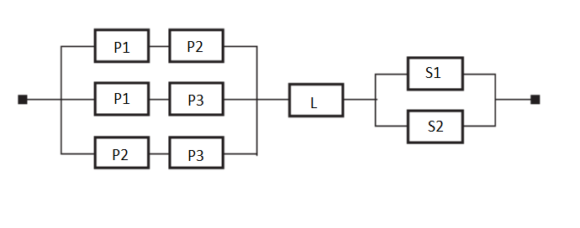
Questions
Convert RBD to Fault Tree and Calculate probability of the top event(system failure)
Calculate minimal cut set for Q1 Fault tree.
What is limitations of standard fault tree?

Slide 44
1)a:
G(system failure)
G1
G2
G3
G4
G5
G6
P1
P2
P1
P3
P2
P3
L
S1
S2

Slide 45
1)b:
Q _{p1, p2} = 1- (1-q1) * (1-q2)
Q _{p1, p3} = 1- (1-q1) * (1-q3) Q _{p1,p2 , p1,p3, p2,p3 =} Q _{p1, p2 *} Q _{p1, p3 *} Q _{p2, p3}
Q _{p2, p3} = 1- (1-q2) * (1-q3)
Q _{s1, s2} = 1- (1-s1) * (1-s2)
Q_{G =} 1- (1- Q _{p1,p2 , p1,p3, p2,p3}) * (1-Q_{L}) * (1- Q _{s1, s2})

Slide 46
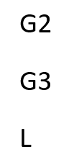
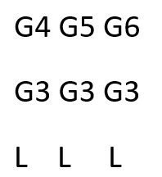
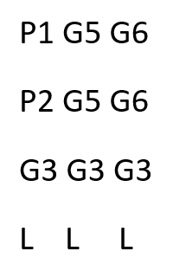
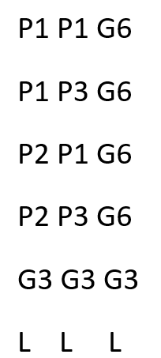

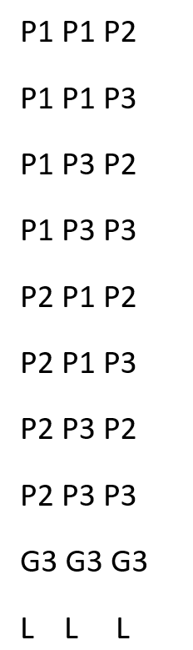
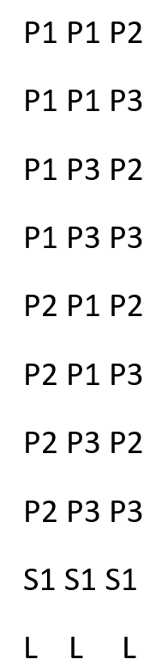
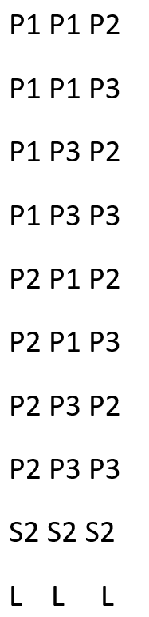
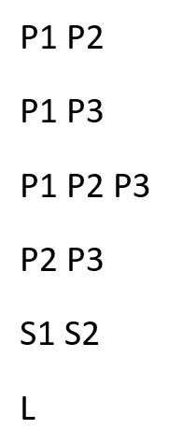
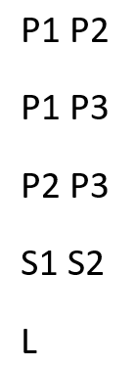
2)

Slide 47
2)
C1 = {P1, P2}
C2 = {P1,P3}
C3 = {P2, P3}
C4 = {L}
C5 = {S1,S2}

Slide 48
3)Answer is in Slide 19
Modern large and complex systems often have the capability to response to failure by partial self-repair. Dynamic behavior of systems lead to different dynamic failure characteristics such as functional dependent events and priorities of failure events. Classical combinatorial fault trees are unable to model such dynamic scenarios.
Another limitation of SFT is that its quantitative analysis is performed based on fixed values of failure data of system components.
Another issue with fault tree analysis is that it is primarily a manual process.
in the manual process the analyses are performed based on the informal system models. As the system design evolves, these informal models could rapidly become outdated.
as the system grows in size, the manual nature of the analysis process increases the risk of introducing error or producing incomplete results.
Need more Time and cost

